Slide 1






GENERATIVE - AI
PROJECT
PRESENTED BY SARANYA C

Slide 2
PROJECT TITLE
FASHION MNIST USING DEEP LEARNING (CNN) ALGORITHM

Slide 3

PROJECT SCOPE
This project aims to leverage deep learning techniques to solve the problem of fashion item recognition from images. By building and training a robust deep learning model, we can achieve accurate classification of fashion items, enabling various applications in e-commerce, fashion industry, and retail analytics.

Slide 4


PROPOSED SOLUTION
By implementing a CNN-based solution for fashion item recognition and following the proposed approach, we aim to develop an accurate and scalable system capable of classifying fashion items from images with high precision. This solution can be applied to various applications in e-commerce, fashion industry, and retail analytics, facilitating automated categorization and improving user experience.

Slide 5
SYSTEM APPROACH - CONT
SOFTWARE REQUIREMENT
Python (>= 3.5): Python is the primary programming language for deep learning projects.
Deep Learning Library
TensorFlow or Keras: These are popular open-source libraries providing tools for building and training deep learning models. Keras often runs on top of TensorFlow.
NumPy: Provides numerical computing functionalities used for data manipulation.
Matplotlib: Used for creating visualizations of the model's performance (accuracy, loss curves etc.).

Slide 6
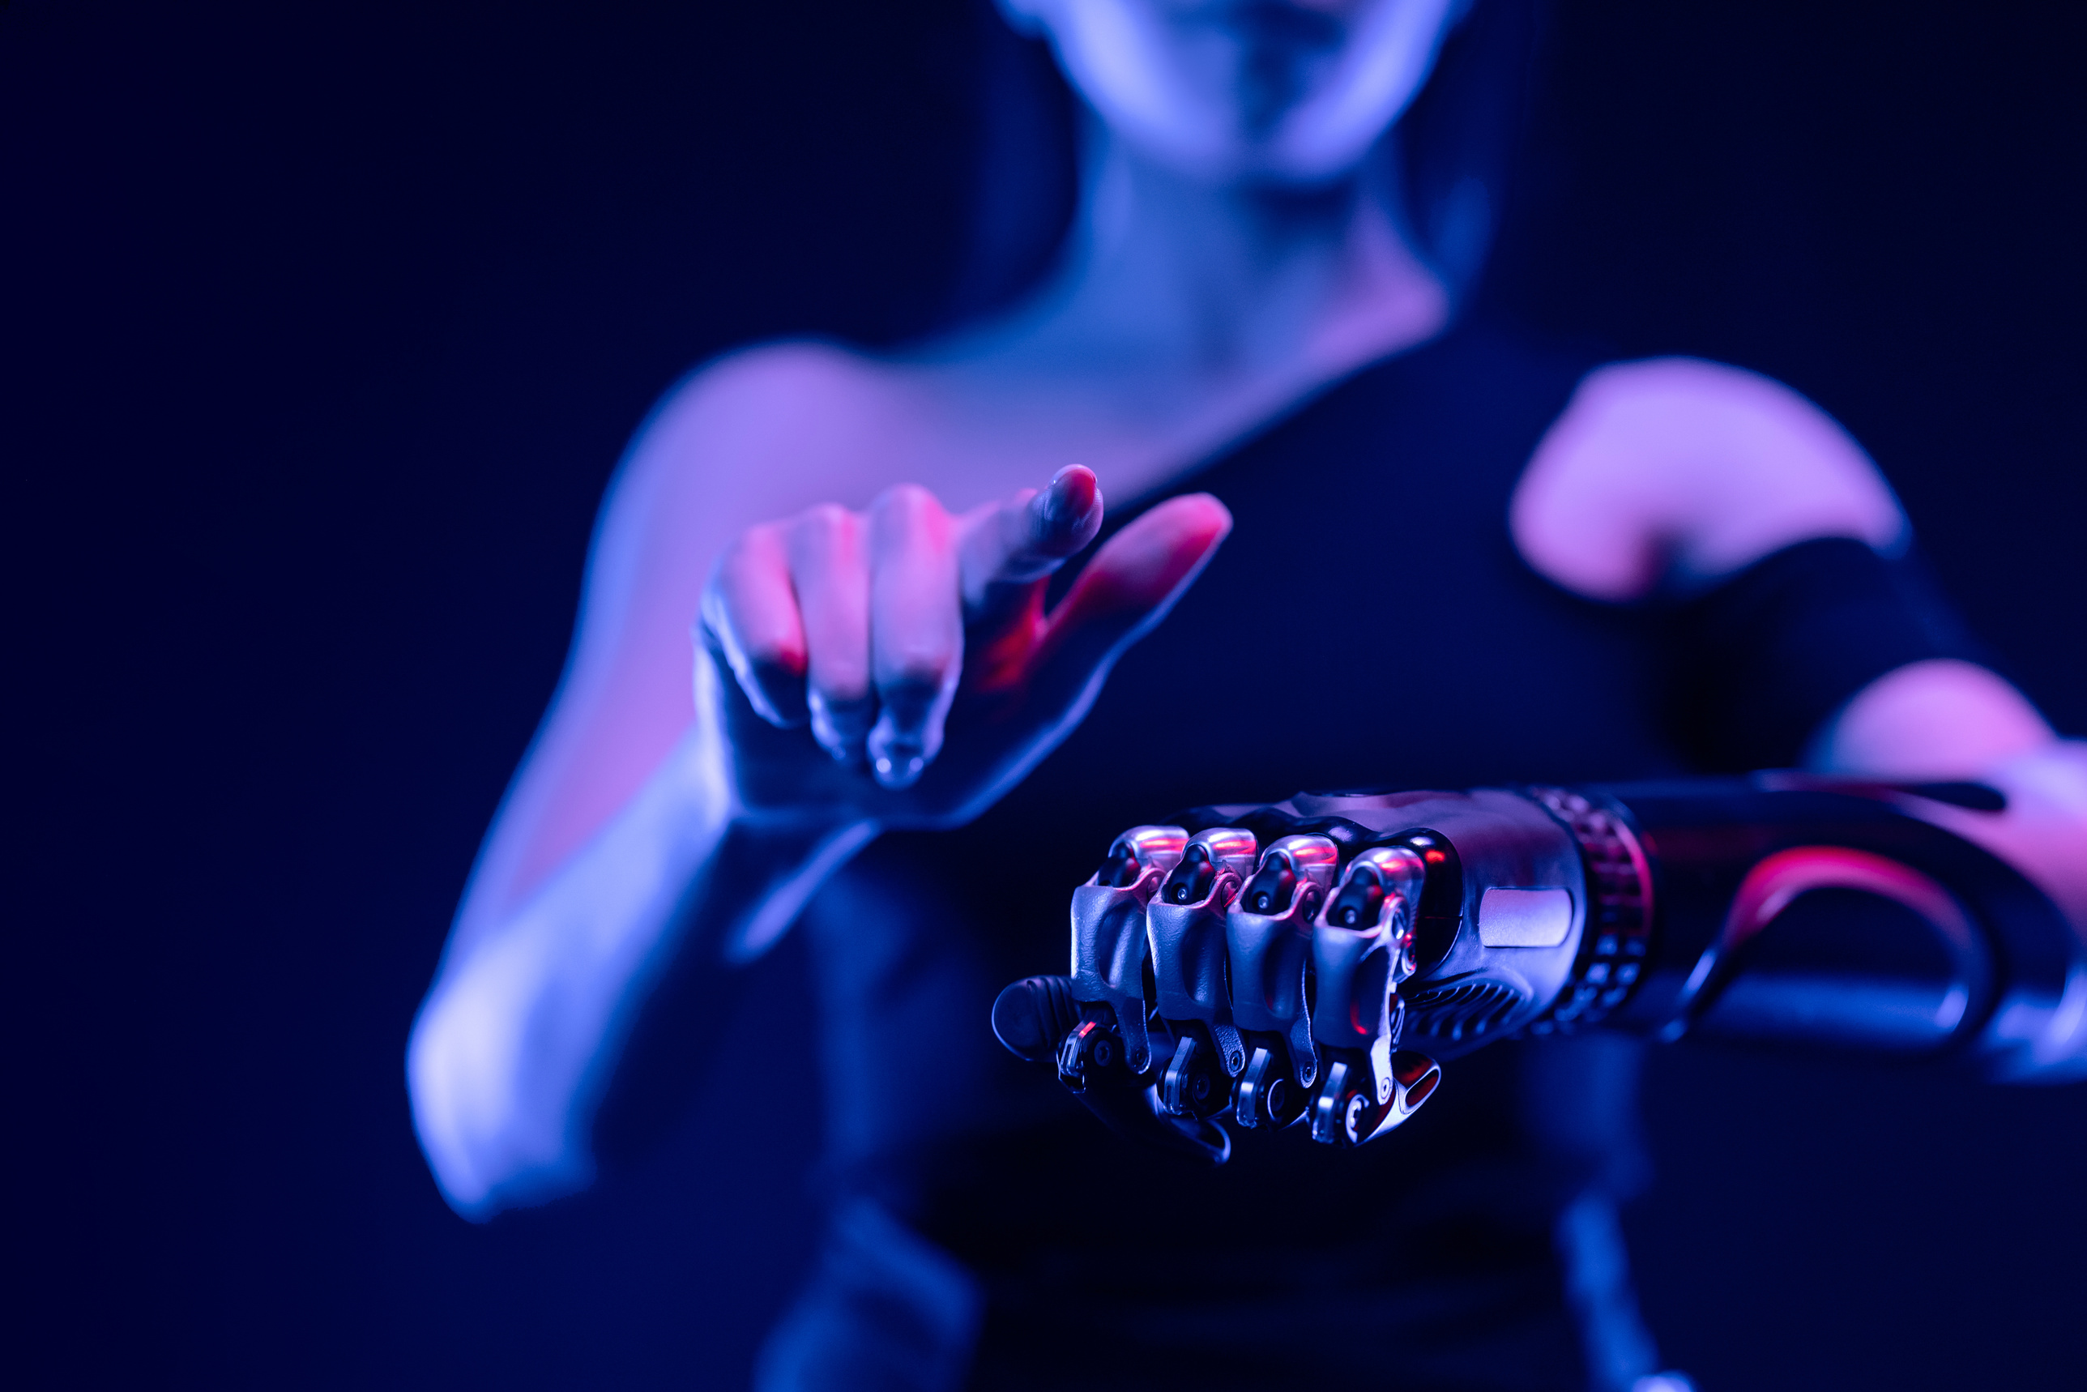

ALGORITHM:
Convolutional Layers: These layers apply filters (also called kernels) to the input image. The filter slides across the image, performing element-wise multiplication with a specific region. The output is a feature map highlighting specific features the filter is designed to detect (e.g., edges, shapes).
Pooling Layers: These layers downsample the feature maps by applying functions like average or max pooling, reducing the image size and computational complexity while preserving important features.
Activation Layers: These layers introduce non-linearity into the network, allowing the model to learn complex patterns. Common activation functions include ReLU (Rectified Linear Unit).
Fully-Connected Layers: Similar to traditional neural networks, these layers perform classifications based on the extracted features.

Slide 7

DEPLOYMENT
On-Premises Deployment:
Deploy the trained CNN model on local servers or dedicated hardware within the organization's infrastructure.
Utilize frameworks such as TensorFlow Serving or Flask to create an API endpoint for serving predictions over HTTP.
Cloud Deployment:
Utilize cloud-based services such as AWS Lambda, Google Cloud Functions, or Microsoft Azure Functions to deploy the model as serverless functions, allowing for automatic scaling and efficient resource utilization.
Use cloud-based GPU instances (e.g., AWS EC2, Google Compute Engine) for inference acceleration, especially for large-scale deployment scenarios or high-demand applications.
Edge Deployment:
Deploy the CNN model on edge devices such as smartphones, IoT devices, or edge servers for inference at the edge of the network, enabling low-latency and offline capabilities.
Optimize the model for inference speed and memory footprint using techniques such as quantization, pruning, and model compression.

Slide 8
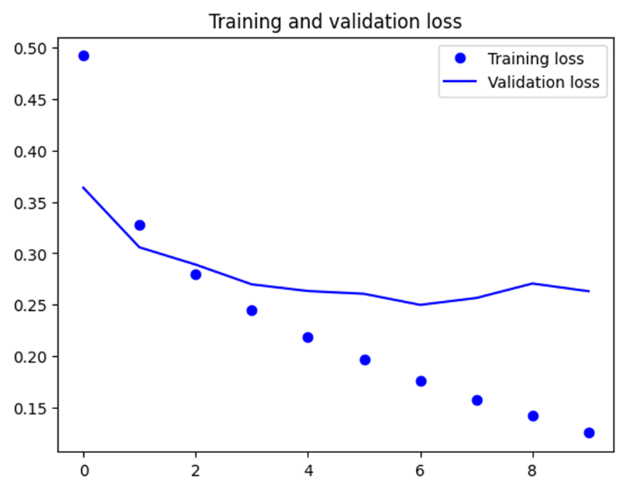

RESULT

Slide 9



CONCLUSION
Deep learning proves its effectiveness in the realm of image classification with the Fashion MNIST dataset. By leveraging Convolutional Neural Networks (CNNs), we can achieve impressive results in distinguishing various clothing articles.

